Slide 1
What Short Rate Model Should I use?
林雅琪 Aki Lin
June 9, 2023

Slide 2
Outline
Introduction
Process
Experiment
Conclusion

Slide 3
Introduction
CIR
dr(t) = a(b - r(t))dt + σ√r(t)dW(t)
Vasicek
dr(t) = a(b - r(t))dt + σdW(t)
CIR
Includes the square root of the interest rate level r(t), which makes the interest rate unable to take negative values, and at levels close to zero, the model responds more smoothly to changes in interest rates
Compare to real par yield

Slide 4
Process

Slide 5
Process
Data
MLE
Parameters
Predicted
Par Yield
Error
1 Month
3 Month
6 Month
.
.
.
30 Year
a,b,σ
MSE
Not Rolling
Rolling
Source:U.S. DEPARTMENT OF THE TREASURY

Slide 6
Experiments

Slide 7
Process
Data
MLE
Parameters
Predicted
Par Yield
Error
1 Month
3 Month
6 Month
.
.
.
30 Year
a,b,σ
MSE
Not Rolling
Training : 30 days
Testing : 90 days

Slide 8
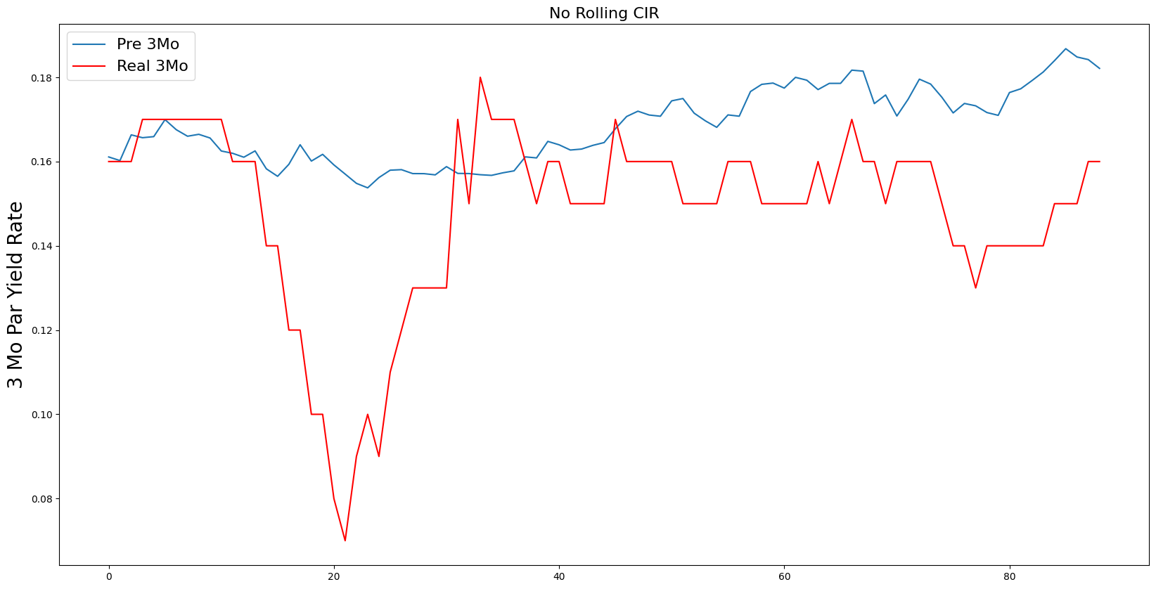
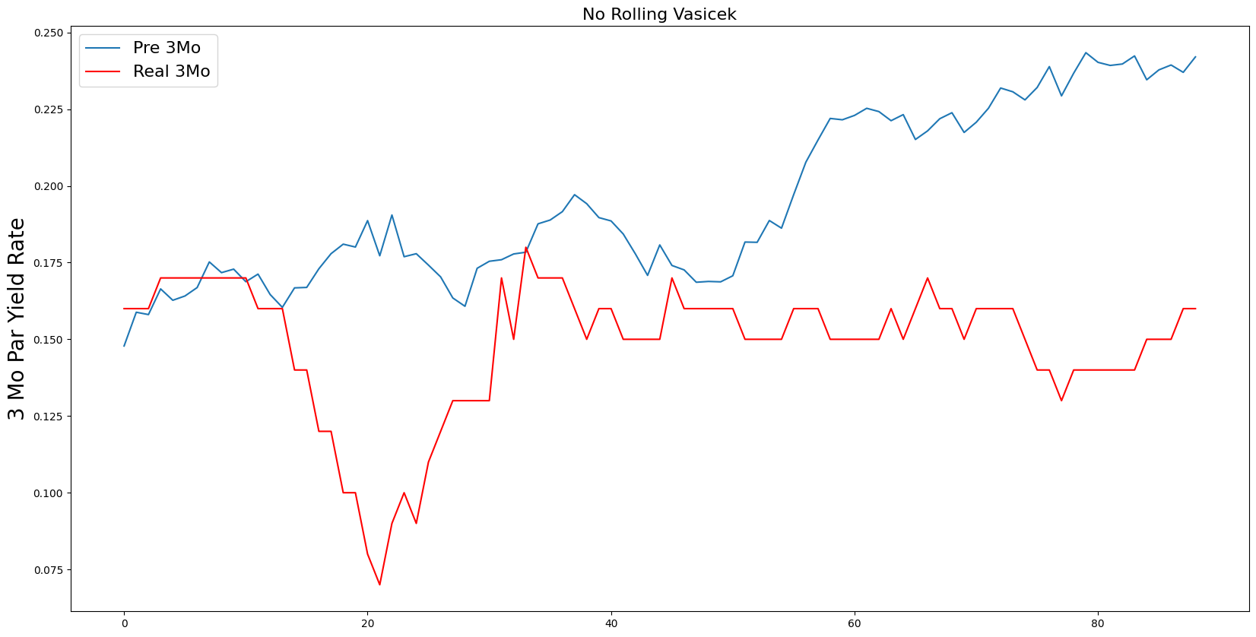
Experiment : No Rolling
Start Time: 2010-05-13
 | CIR | Vasicek
MSE | 0.1459 | 0.0034

Slide 9
Process
Data
MLE
Parameters
Predicted
Par Yield
Error
1 Month
3 Month
6 Month
.
.
.
30 Year
a,b,σ
MSE
Rolling
Training : 30 days
Rolling Testing : 1 days

Slide 10
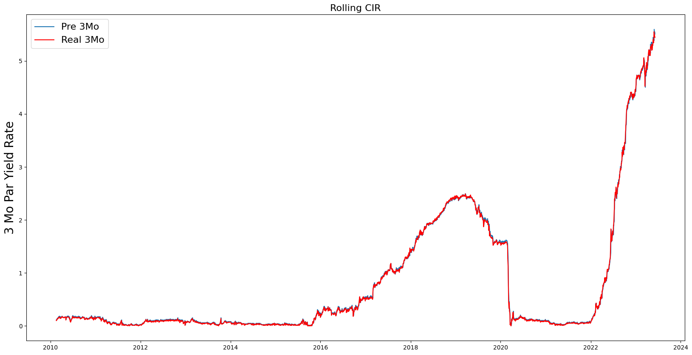
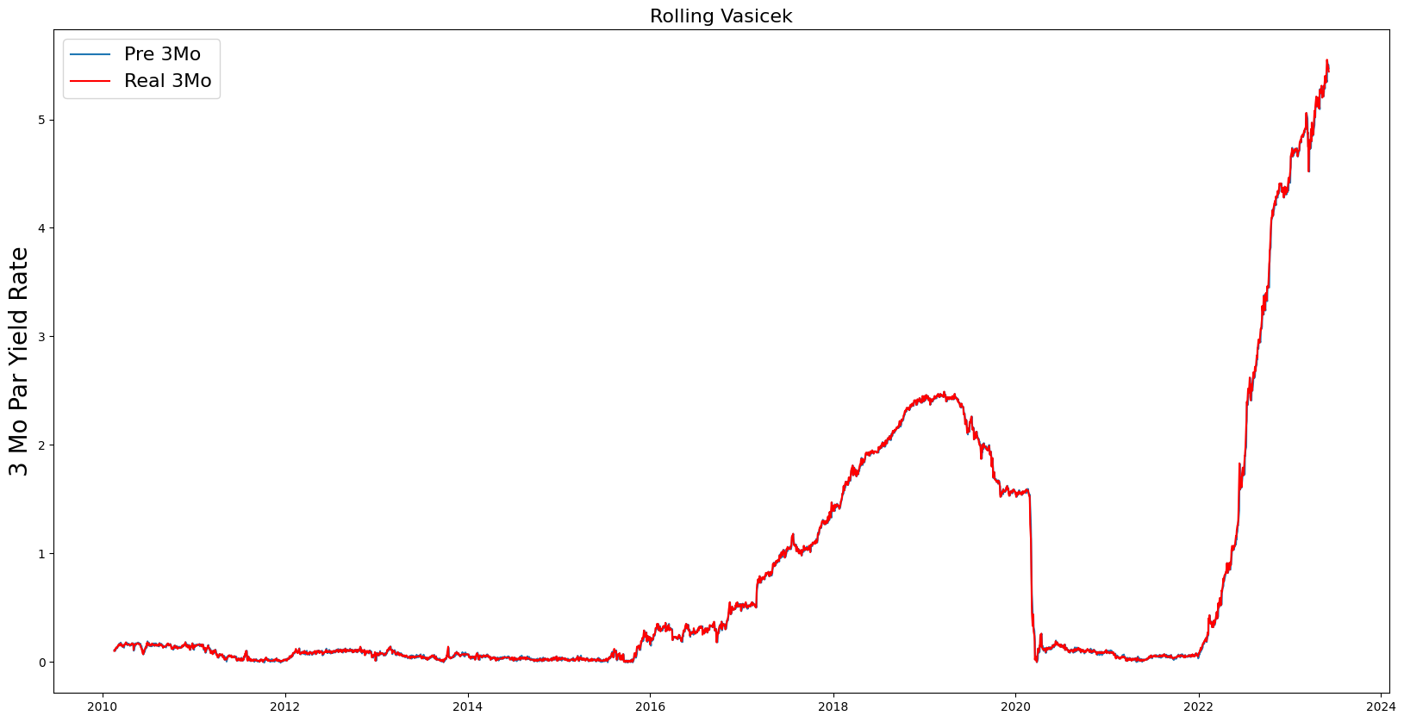
Experiment : Rolling
Start Time: 2010-05-13
 | CIR | Vasicek
MSE | 0.0009 | 0.0007

Slide 11
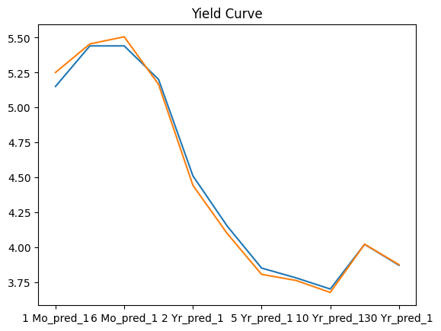

Experiment : Yield Curve
Time: 2023-06-06
v | CIR | Vasicek
MSE | 0.0244 | 0.0340

Slide 12
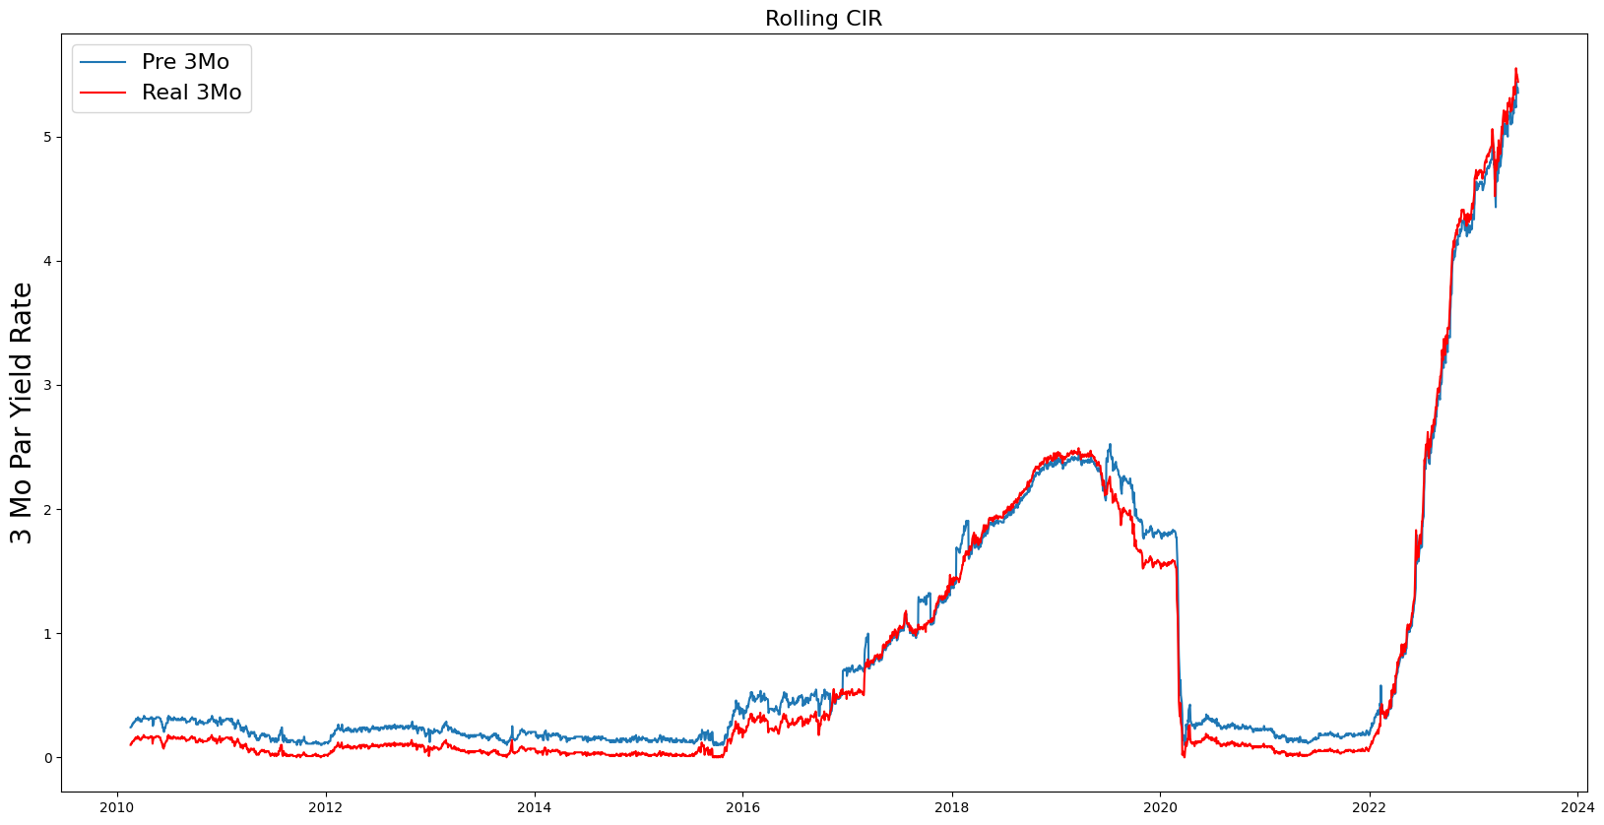
Conclusion
Influenced by parameters’ setting
Sensitivity analysis
Collect different countries’ data
Test different timeframe

Slide 13
Thanks!
林雅琪 Aki Lin
June 9, 2023

